Slide 1
CWB Digital Alignment Workshop

Slide 2
Agenda
Morning:
House Keeping - Jason
Introductions - All
Why are we here: Goals/Intent – Jason
Values - Jason
Business Strategy – Christina
Technology strategy / priorities - Azfar
Technical Design Discussion – Azfar/all
Afternoon:
Breakouts, additional design Q/A
Document decisions, address parking lot items

Slide 3
Housekeeping
Rooms
Washrooms
Snacks/Lunch

Slide 4
Introductions
CWB
Thirdstream
Temenos
Bits In Glass

Slide 5
Goals and Intent
Why are we here?
ALIGNMENT / CLARITY for all stakeholders.
Business scope, strategy, vision
I.S. scope, strategy, priorities
Timelines
Stakeholder engagement
Design maturity
Enough clarity to provide high level $ estimates back to CWB by end of September.

Slide 6

New CWB Brand

Slide 7
New CWB Values and Brand
People First – Caring people are the key to our success. We work as a team and support one another. We treat each other with respect and have the courage to be candid.
Inclusion Has Power – diverse teams unleash new ideas and perspectives. We are aware of our biases. We are proud of who we are, and we are allies for those around us.
Relationships get results – clients choose CWB for the best experience. We build relationships proactively with intention and consistency. Our results depend on it.
The how matters – how we do things is as important as what we do. Take ownership, and move with urgency and efficiency. We always act with integrity, and balance risk and reward.
Embrace the New – change is everywhere. We seek out new ideas and are committed to continuous learning. We know that better is always possible.
Notes:
People first – people play a large part of all theses values and clearly the people in this room and the teams you represent are vital to our success. We’re going to be candid and courageous but respectful in how we deal with each other
Inclusion has power – we are a diverse group in this room – even the cwb team has a diverse background – bringing in all kinds of expertise to make sure we’re looking at this from all the right angles. Word in here of allies resonated with me – you are all our allies on this journey and we need you to feel the same about everyone else around you here.
Relationships get results – where would we be without this one . Our relationships with our clients are important but for this to be successful our relationships with each other need to be strong – our results depnd on it.
How matters – when rolled out this is the one that resonated with me the most – taking ownership . Having that pride of ownership. Move with urgency and efficiency but at the same time ensuring we’re blaancing risk and reward. As we get into timelines here – theres some aggressive targets – we’re not aiming for perfection , we’re aiming for excellence, and we’re going to have a biasness for action and rightsizing our solutions. Eye to the future
Embrace the new – digital is a buzzword everywhere and it’s a new theme for cwb. New to us but not for you – we need your help to implement this for our growth strategy for this organization and we know that better is possible here.
“and we need to ensure our new experiences support our existing customers while contributing to the growth of our base, with new solutions that will meet the needs of each segment.”

Slide 8
Additional Level Setting for Today
Parking lot
Expectation is ask, ask, ask.
Scope clarity to get to high level estimates
Avoid in-room commercial discussions
Biasness for decision making where we can
Some assumptions may be wrong
High Level Design – 90% after today.
CWB decision makers on who is doing what.
Stay out of the weeds – we’re not solutioning.

Slide 9
CWB Digital Strategy

Slide 10
Digital Strategy Overview
Advancing CWB’s Digital Capabilities is a strategic imperative to support our growth agenda
Technological advances are causing client behaviour and the way they are interacting with banks to change
The benchmark for user experience is no longer other FI’s but leading digital players (e.g., Amazon, Google etc.)
Recent investments have created a best in class technology infrastructure but our digital capabilities are largely reliant on platforms designed for credit unions
We offer the same functional services as larger banks, but our capabilities are provided by multiple service providers resulting in a complex and poor user experience and limited ability for online sales
To realize our vision of being the Best Bank for Business Owners we need a viable solution for small business (SB) owners and an integrated experience for Commercial customers.
Digital creates an opportunity to deliver a compelling offering without the cost or geographic limitations of the face-to-face channel
Our digital strategy has three main areas of focus
Open a new avenue for client and deposit growth by offering digital onboarding and with a new small business platform
Upgrade our digital banking to include an integrated experience that will enhance the overall client experience for all segments
Utilize new digital capabilities to improve our in-branch processes

Slide 11
Our Digital Capabilities are Functionally at Parity But Don’t Deliver Our Desired Experience or Growth Opp.
CWB Current State
CWB Target State
Functionality offered mirrors the big 5 banks, but is still missing key usability and other components needed for a holistic digital solution
Challenges include:
Core services offered from different vendors (C1, Western Union, CUPS etc.)
Customers need to manage multiple user id’s and passwords
Setup of users and permissions separate for each service
Lack of consistency and dated user interfaces
Very limited online sales capability with manual fulfilment
Branches unable to leverage digital solutions
Integrated end to end offering from a single partner with single sign-on and common User Experience (UX) for specialized services where required (e.g. eDeposit)
Simple intuitive user interface with single access to setup and manage all user permissions
Differentiated experience for each segment (Small Business, Commercial and Personal), with specific functions for individual segments
Digital onboarding for deposit accounts, credit services etc. for all clients, with commercial facilitated via an RM
Automated fulfilment to setup clients in minutes vs. days
Extend digital solutions to Branches to improve employee and client experience, data quality/compliance

Slide 12



Our Digital Strategy Has Three Key Pillars
New Small Business Platform
Integrated Client Experience
Extend to branches
Open a new avenue for client and deposit growth through the creation of a small business platform
Upgrade our online banking and integrate user experience to enhance the digital client experience for all clients
Utilize new digital capabilities to improve our in-branch processes
1
2
3

Slide 13
Draft in Progress
Preliminary Digital / Technology Roadmap
F19
F20
F21
F22
F23
New Digital Capabilities
Personal / Motive DAO
Motive Lending
Small
SB Sales & Onboarding Platform (DAO, Lending, Value Add)
Medium
Large
Digital Banking Upgrade(Personal, SB, Corp)
X-Large
Common UX, Single Sign-on
Branch Channel Improvements
Personal Account Opening
SB/MM Account Opening
CRM (SalesForce)
New Technology and System Upgrades
Mulesoft
CAFT Upgrade
T24 Upgrade
WAVE Upgrade

Slide 14
CWB - Information Services Strategic Priorities

Slide 15
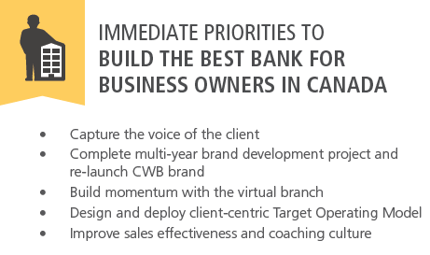
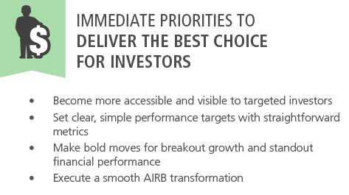



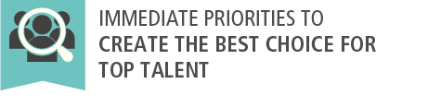

Alignment of Strategic Direction to IS Operational Plan
Pillars of Execution
Increase Customer Intimacy
Extremely relevant
Hard to miss
Fast, smart, smooth and easy
Available everywhere all the time
Fiercely competitive
Increase Top Line Growth
Enhance Performance Management
Accessible, external focus
Simple and straightforward
Fast-growing and clearly differentiated
Diversified by geography and industry
Reliable, stable profitable
Valuable franchise
Caring
Flexible, diverse and inclusive
Bold and decisive
Agile and ready for change
Performance-driven
Provide a diverse, flexible and stimulating workplace

Slide 16



Information Services Value Proposition
Availability of secured services any time, any where on any device
BEST FOR BUSINESS OWNERS
BEST FOR INVESTORS
BEST FOR TOP TALENTS
Manage, coach
Support key strategic priorities
Manage ongoing cyber security maturation
Deliver on key initiatives to support end users and customers
Maintain standards on operational service levels
Develop talents
Skills upgrade
Culture
Value
People
Technology
Process
Innovative and integrated technology solutions
Availability of secured services any time, any where on any device
Information Visibility, Customer insight
Process Efficiency
Infrastructure Innovation
Digital enablement
Customer-driven growth

Slide 17







Our Journey
Key Technology Themes
Technology Governance
Digital Transformation
Enhancing Customer Experience
Leveraging Information
Cyber Security
Workforce Preparedness
WORKPLACE OPTIMIZATION
Enterprise Data Warehouse
Enterprise Info. Mgmt.
Office 365, Windows 10
HRIS Phase 2
CWF System Replacement
Target Operating Model
External Website Enhancements
eSign for Motive
AIRB – Scorecard Operationalization
Integration of National Leasing
Enhanced External Website
Sitecore Upgrade
LEVERAGING INFORMATION & DIGITAL TRANSFORMATION
Enterprise Data Warehouse Project
Enterprise Information Management
Information Integration
Small Business platform
Remote Deposit Capture
Launch and Motive rebranding
2016
2018
2019
2017
APPLICATION MODERNIZATION
Went live with T24
Wave upgrade
Wealth Management Platform
Initiation of the Enterprise Data Warehouse Program
ENHANCING CUSTOMER EXPERIENCE & CYBER SECURITY
Human Resources Information System (HRIS)
Enterprise Document Management
Mortgage Back Securities (MBS)
Remote Deposit Capture - Mobile
Funds Transfer Pricing - TIP
Mortgage Back Securities
Adobe LiveCycle Upgrade
Security Program
Advanced Disaster Recovery Preparedness (WAVE/FileNet)
AIRB – Scorecard Operationalization
Virtual Branch
Integration of Maxium
CWB Place Phone Replacement
External Firewall Replacement

Slide 18

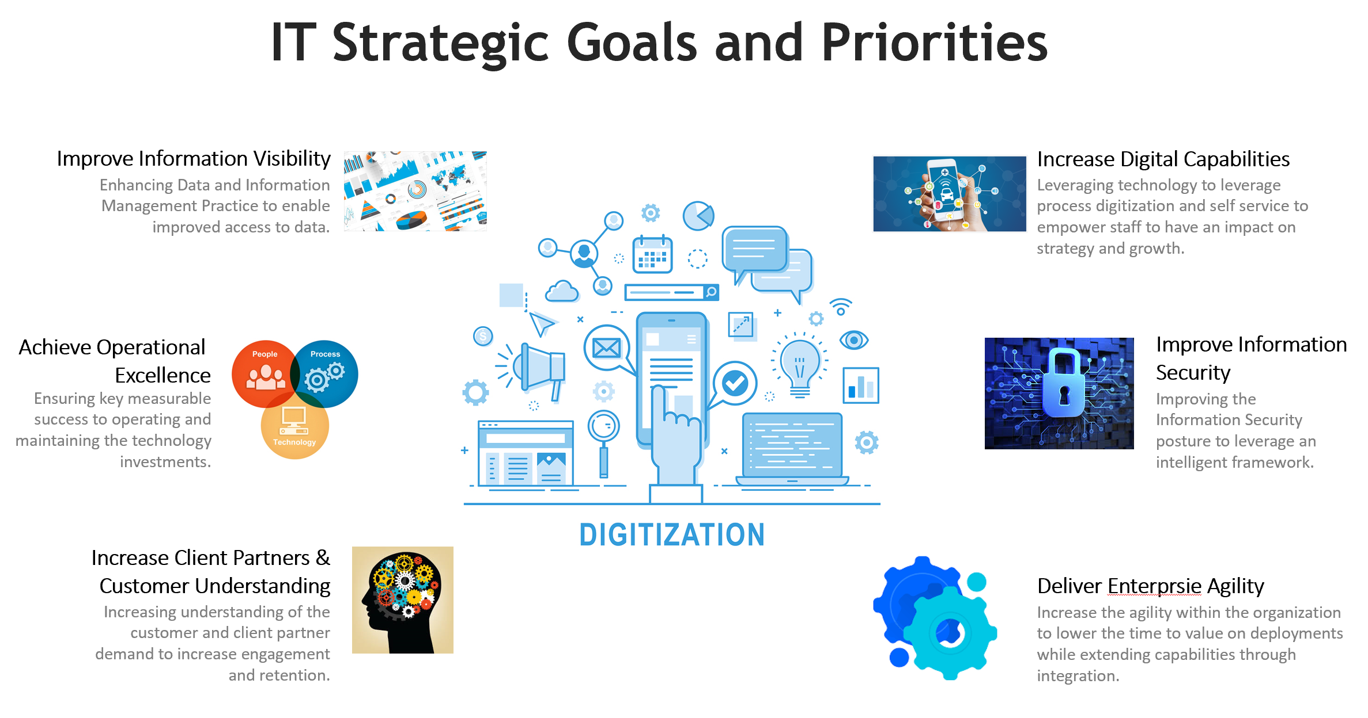

Information Services Strategic Focus
Information Security Transformation
Through collaborative efforts across the organization deliver on the promise to enable transformation growth while maintaining the confidentiality, integrity and availability of our information assets
Evolve Digital Capabilities
Expand our digital ecosystem leveraging our application, infrastructure and data assets. Encourage customer interaction and support staff through digital tools. Leverage advancements in cloud computing and mobility to enhance the user experience
Develop Analytical Insights
Enhancing our ability to provision and provide consolidated, trustworthy, normalized data to empower decision making, optimize resource management, and enhance service quality
Achieve Operational Excellence
Ensuring measurable success and material improvements in operating and maintaining technology investments.
Deliver Enterprise Infrastructure Agility
Investing in infrastructure that allows for agile delivery of services, automation and efficient use of resources through scalable and reliable architecture

Slide 19
Strategic Priorities
EVOLVE DIGITAL CAPABILITIES
Online Banking for Small Businesses/Digital Onboarding
Application Modernization
Digital Collaboration Tools (O365, Teams, OneDrive)
Enterprise-wide Digital Collaboration Improvements
End User Access Management
Enterprise-wide Wireless Connectivity
ENHANCING CUSTOMER EXPERIENCE & CYBER SECURITY
Delivering on the Enterprise cyber security framework
End User Access Management
DEVELOP ANALYTICAL INSIGHTS
Enhancement of our Business Intelligence / Data Analytics / Artificial Intelligence capabilities
DEVELOP ANALYTICAL INSIGHTS
Broaden Application of AI
2020
EVOLVE DIGITAL CAPABILITIES
Replacement of Mobile/Online Banking for Business and Personal
Application Modernization
Enablement of Digital Services
Enhancement of End Customer Touch Points
ACHIEVE OPERATIONAL EXCELLENCE
End User Software License Management
Enterprise Software License Management
Corporate Network Upgrades
SDLC Tools
Help Desk Maturity
EVOLVE DIGITAL CAPABILITIES
T24 and Wave Core Application Upgrades
Enablement of Digital Services
Enhancement of End Customer Touch Points
DELIVER ENTERPRISE INFRASTRUCTURE AGILITY
Enablement of Cloud/Cloud-like Infrastructure
2021
DELIVER ENTERPRISE INFRASTRUCTURE AGILITY
Enablement of Cloud/Cloud-like Infrastructure
Enhancement of Disaster Recovery Capabilities
Infrastructure Services Upgrades
2023
DEVELOP ANALYTICAL INSIGHTS
Broaden Application of AI
DEVELOP ANALYTICAL INSIGHTS
Broaden Application of AI
ACHIEVE OPERATIONAL EXCELLENCE
Application Modernization
Enablement of Digital Services
Enhancement of End User Tools
Infrastructure Services Upgrades
SDLC Tools
Service Accessibility over Mobile
ACHIEVE OPERATIONAL EXCELLENCE
Application Modernization
2022
DELIVER ENTERPRISE INFRASTRUCTURE AGILITY
Enablement of Cloud/Cloud-like Infrastructure
Network Infrastructure Modernization - 5G/SDWAN
ACHIEVE OPERATIONAL EXCELLENCE
Application Modernization
DELIVER ENTERPRISE INFRASTRUCTURE AGILITY
Enablement of Cloud/Cloud-like Infrastructure
Infrastructure Services Maintenance

Slide 20
Where CWB is at
Part of the stack that drives user experience and functionality
Information Security
Business Intelligence / Data Analytics
/ Artificial Intelligence
Front End Systems
CRM (Providing access to all services used by front end staff for the customer)
Online Banking (Customer self-serve)
Digital 3RD Party Services
Front End
Front End
Front End
Native Application
Real-Time Messaging Integration
API Integration
Types of integrations (Enterprise Service Bus)
Application specific front end
Real-time integration (specific to channel)
API integration – specific to service being consumed by channel (i..e many channels consuming the same service)
Network
Application Workflows
Core Applications
Core Banking Systems
Workflow Application
Financial Book-Keeping
Application Functionality
Accounting Systems
Infrastructure
Network Connectivity across all locations
Data Centre capabilities
Virtual machines
Enablement of Cloud-based services
Bare Metal
Virtualized
Cloud
complete
in-progress
to be completed
Notes:
\

Slide 21
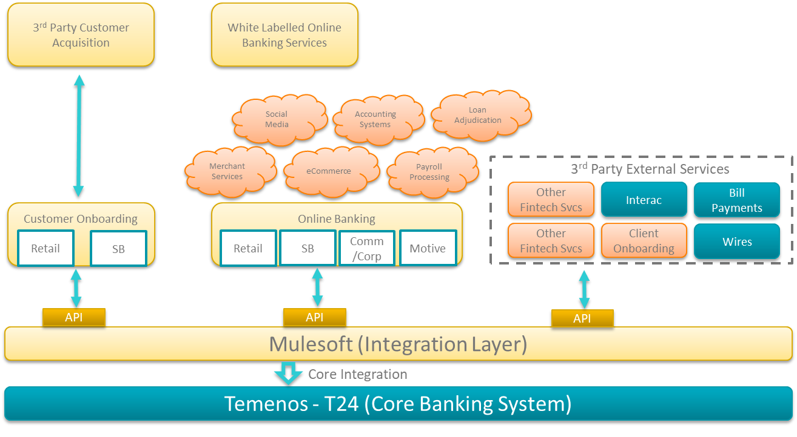
Recent Investments Have Created a Best In Class Technology Infrastructure
Most significant product investments that would influence the execution of our digital strategy would be:
Investment in our core banking system (Temenos) – 2016
Investment in our integration platform (Mulesoft) – 2019
Decision on our online banking platform (e.g. Temenos – Infinity) – 2020
Domestic KYC/AML API services for Digital Onboarding (e.g., Thirdstream)
All the partners we have chosen for our technology infrastructure to support the digital strategy are best-in-class. Over the next year, the most important part of our implementation of digital solutions is going to be the design of our integrations across CWB applications.

Slide 22


Solution Architecture based on Temenos Infinity
New to Bank
unsecured
Mobile
secured
Internet
secured
Call Centre
Branch
Agent
Chat
Chat-bot
ATM
API
Journey Manager User Journeys (New-to-Bank & Existing Customers)
UX
User Agents (Bank Staff & Customers)
APIs
Marketing
Single Customer View - CRM
Servicing
Customer Profitability
Watchlist
Real-time Engagement
Engagement Decision Engine
Account
Aggregation
Money Mgmt/PFM.
Predictive Analytics
KYC
Sales
Alerts &
Notifications
Contact log
Marketing Catalogue
Onboarding
Origination
Journey/
Clickstream Analytics
AML
Workflow
Fraud
Embedded Analytics
Document Management
Secure Messaging
Decisioning Rules
Business Support
Risk &
Compliance
User
Management
Consent
Reporting Dashboard
Document
Output
Monitoring & Logging
Holdings
Analytics &
Reporting
API layer
Core banking engine [T24 R12]

Slide 23
Wrap Up – End of Day

Slide 24
Wrap Up – End of Day
Parking lot items will be documented
Temenos has full list of action items
Distribution of selected slide material
Any concerns on technology – escalate to Jason
Feel free to email myself or Christina any time
Next steps – what else do you need from us in short term?
Thank you!

